Slide 1
Employee Data Analysis using Excel
STUDENT NAME: AKSHITHA. A
REGISTER NO: 312215945, asunm1621312215945
DEPARTMENT: B. Com General
COLLEGE: Shri Shankarlal Sundarbai Shasun Jain College for Women

Slide 2
PROJECT TITLE
Employee Performance Analysis using Excel

Slide 3


AGENDA
Problem Statement
Project Overview
End Users
Our Solution and Proposition
Dataset Description
Modelling Approach
Results and Discussion
Conclusion
3/21/2024 Annual Review

Slide 4

PROBLEM STATEMENT The main objective of Employee Performance Analysis is to create an analysis model that makes performance management at individual employee level simpler. It is very helpful for predicting and monitoring employee performance using previous appraisal records and other employee related data such as experience, age, academic qualification, professional training, gender and marital status.

Slide 5

PROJECT OVERVIEW
Analyzing the performance of employee by considering various factors like performance level, gender, rating, achievements. Analysis based on these is called Employee performance analysis. This activity of employee evaluation has a high significance in making strategic decisions of manpower planning.
This project was really helpful in looking after the employee’s performance analysis more clearly. This helps the company as well to keep a track on performance of employees.

Slide 6




WHO ARE THE END USERS?
Employees: Performance reviews can help employees grow in their roles and careers. They can also help employees identify areas where they can improve, and can be an opportunity to reinforce expectations.
Managers: Performance reviews can help managers make better decisions, and can improve communication between managers and employees. They can also help managers identify training needs and set goals.
Organization: Performance reviews can help improve workplace productivity, and can help the organization identify what is working well and what isn't.

Slide 7

OUR SOLUTION AND ITS VALUE PROPOSITION
Filtering – Missing values
Conditional formatting – Blank values
Pivot table – Summary
Chart – Data visualization

Slide 8
Dataset Description
EMPLOYEE – GIVEN DATA
26 – FEATURES
9 - FEATURES
EMP-ID-NUMBER
NAME – TEXT
EMPLOYEE TYPE
PERFORMANCE LEVEL
GENDER – MALE FEMALE
EMPLOYEE RATING – NUMERICAL VALUE

Slide 9

THE "WOW" IN OUR SOLUTION
PERFORMANCE LEVEL = IFS(Z8>=5,”VERY HIGH”, Z8>=4,”HIGH”, Z8>=3,”MED:,TRUE,”LOW”)
3/21/2024 Annual Review
9

Slide 10
MODELLING
Given data collection
Features collection
Data cleaning
Technique
Performance level
Pivot table
Slicer
Graphs
Chart title
Chart elements
Result
10

Slide 11
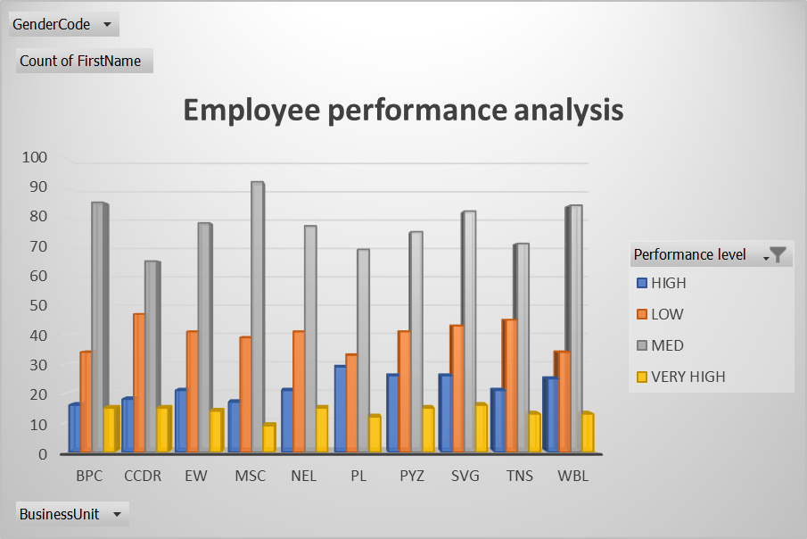
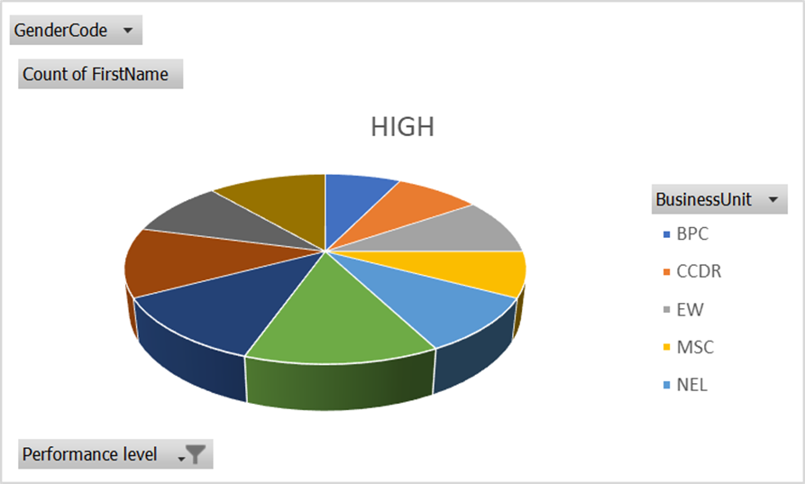
RESULTS
11

Slide 12
Conclusion
In conclusion, the use of EXCEL and POWERPOINT for employee data analysis proves to be highly effective for visualizing and presenting key insights.
Excel allows for efficient data manipulation, statistical analysis, and visualization through charts, pivot tables, formulas, making it a powerful tool for exploring employee data and identifying trends.
PowerPoint complements this by providing a platform to present the results in a clear, organized, and visually appealing manner.

